Slide 1
SEL Family Activity (K-2)
Week of June 22, 2020
Worrying
©TheSocialEmotionalTeacher

Slide 2
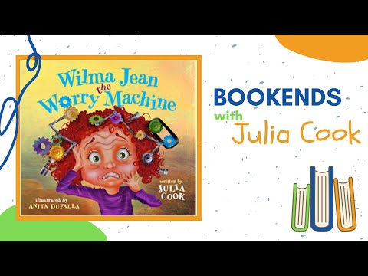
Think:
What are some of the worries Wilma Jean has? Can you relate to her worries?
What happens to Wilma Jean when she worries?
What did Wilma Jean’s teacher do to help Wilma Jean with her worrying?
Why is sorting our worries (like Wilma Jean’s teacher did) helpful?
Do:
Make a list of your worries.

Slide 3
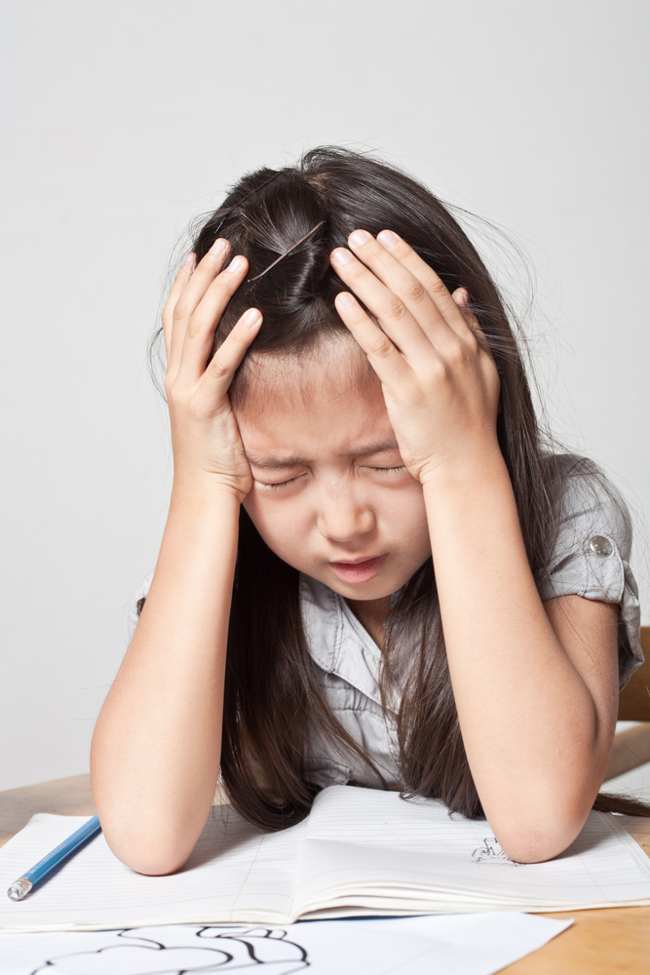
Activity:
Write/Draw something you worry about. Then, draw a circle on a piece of paper. Have a grown up help you “sort” your worries between what you can control and what you cannot. Now you and your grown up can work together on the worries you can control.

Slide 4
SEL Family Activity (3-5)
Week of June 22, 2020
Conflict Resolution
©TheSocialEmotionalTeacher

Slide 5
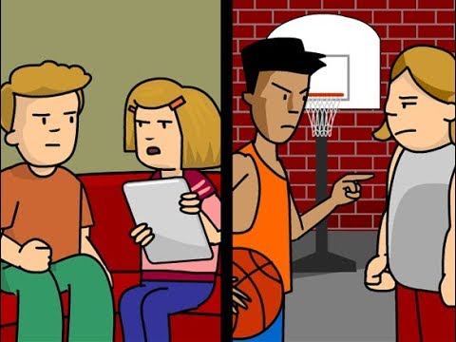
Think:
What is an example of a conflict from the video?
When have you felt angry or frustrated over a conflict?
Why is using anger or frustration not the best choice?
What is a strategy for calming down?
Why should you not ignore every conflict?

Slide 6
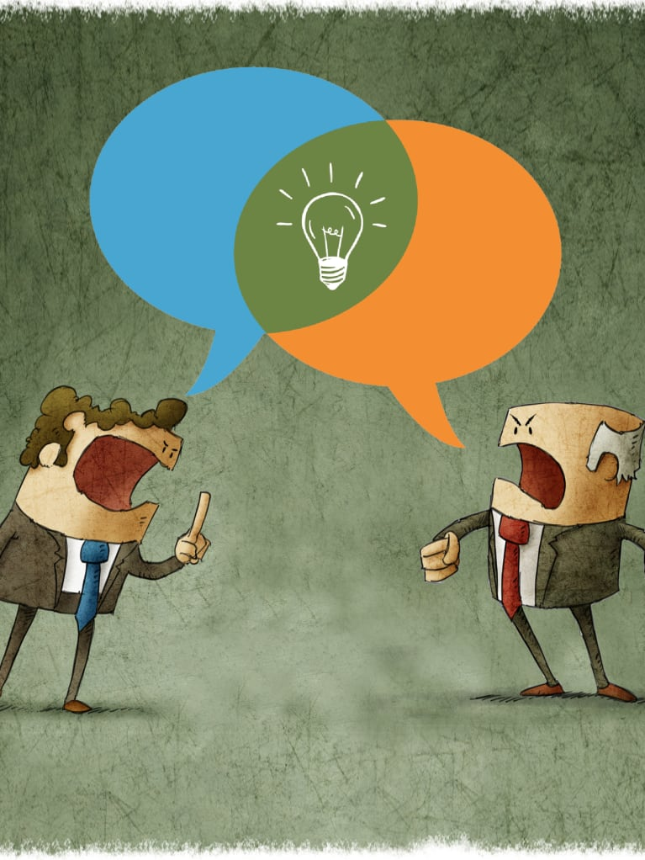
Activity:
Write about a time you had a conflict. What happened? How did you work to solve the problem? Would you do anything differently next time?

